Slide 1
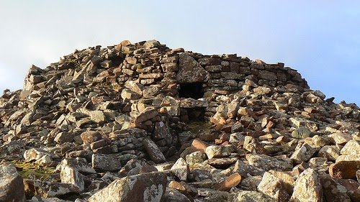
WHAT DO YOU THINK THIS HEAP OF ROCKS ONCE WAS?
It is about 15m from side to side.
Is that bigger or smaller than your classroom?
Can you see a doorway into it?
Talk about your ideas.

Slide 2
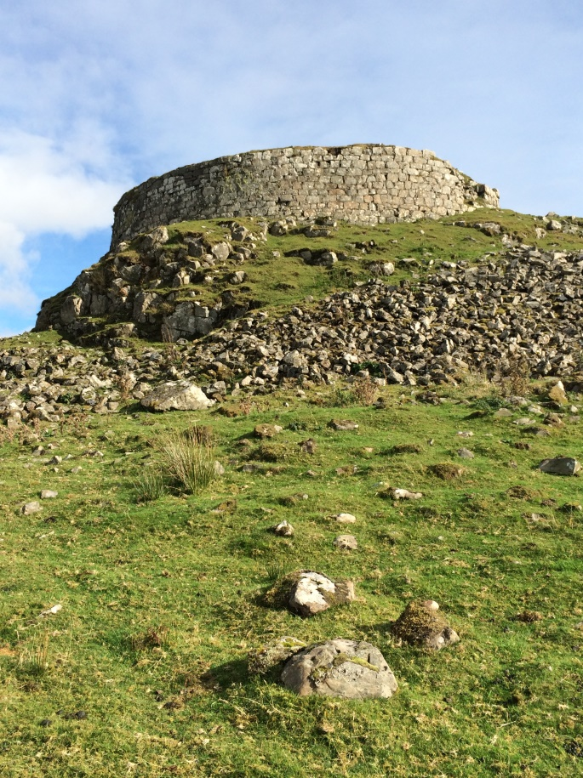
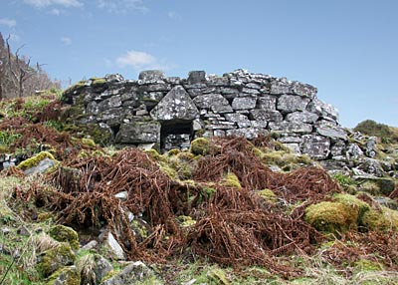
Here are two more like it but their walls haven’t collapsed as much.
What shape are they?
How high do you think the walls would be if all the rocks around them were put back?

Slide 3
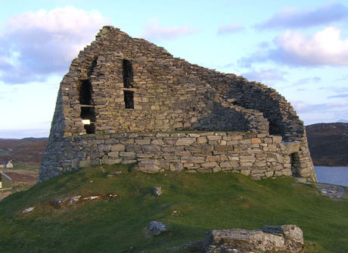
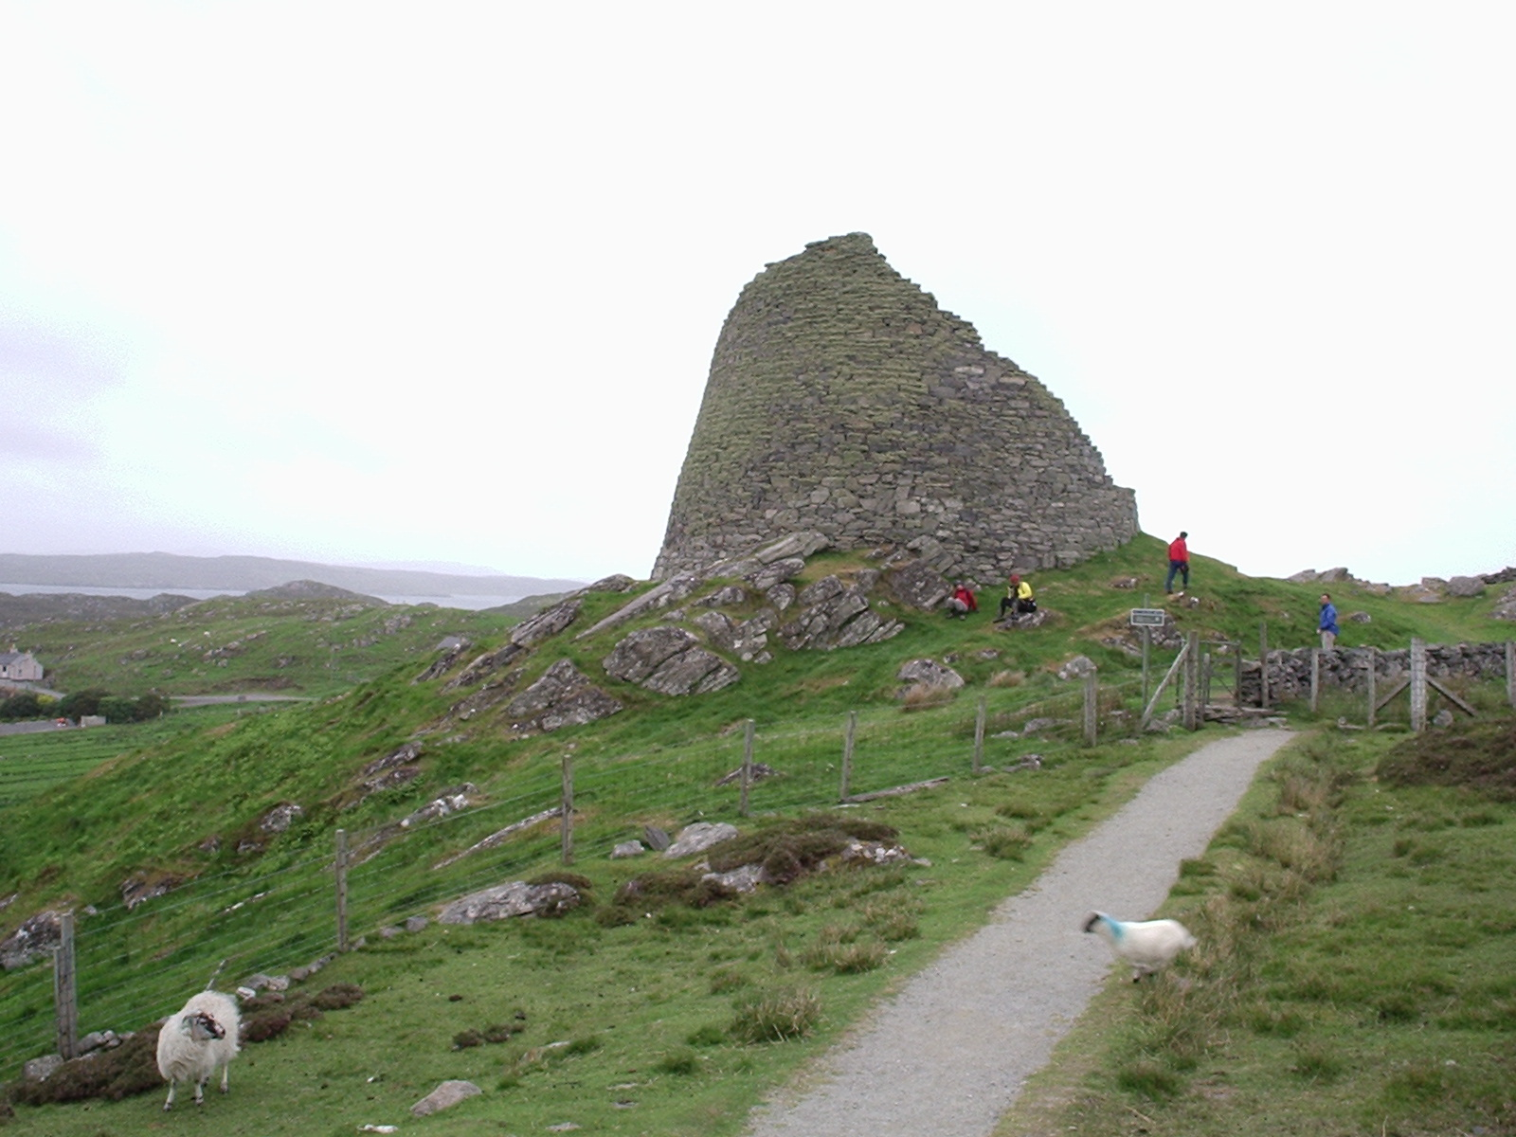
This one is better preserved. Just part of it has fallen down.
It is open in the middle.
If the man below is 1.5m tall,
measure how high the building is?
Can you see the building has double walls?

Slide 4
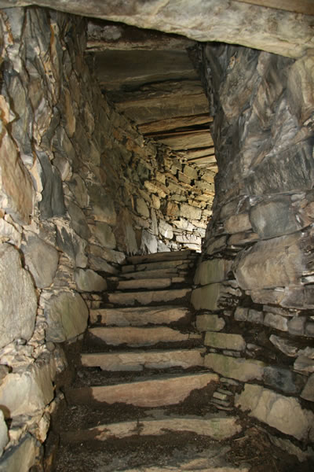
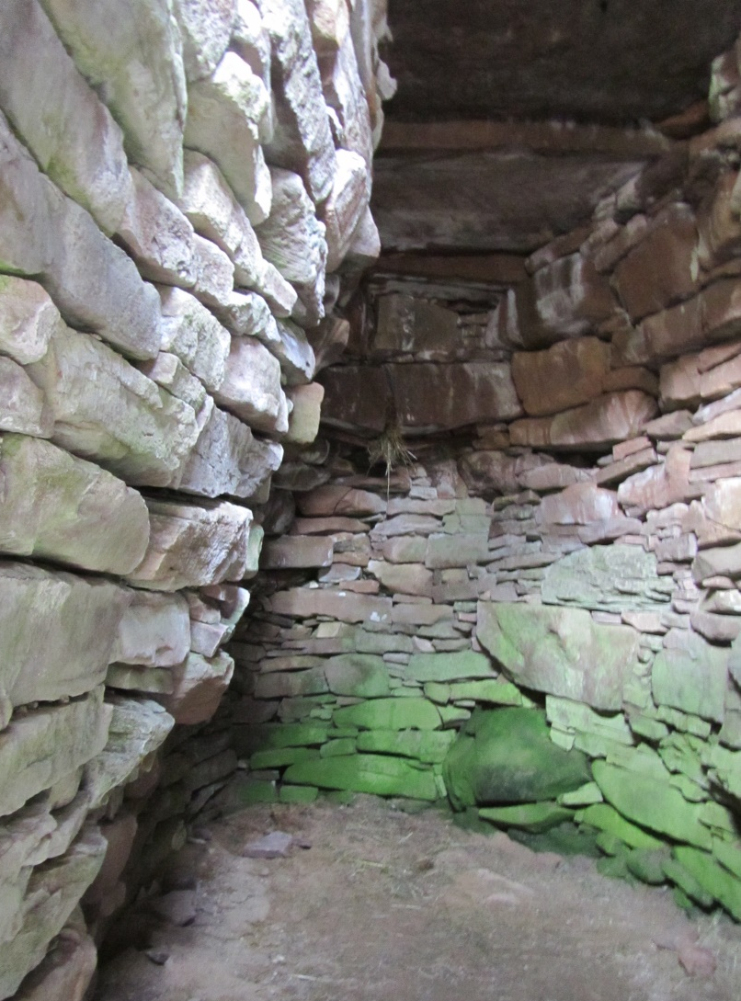
Between the walls
This is a room beside the only entranceway.
Who do you think would stay here?
Where do you think these stairs lead?

Slide 5
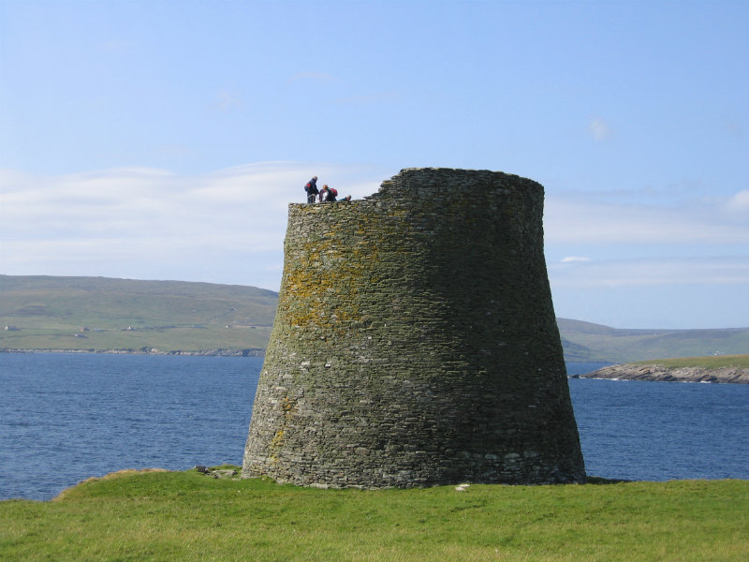
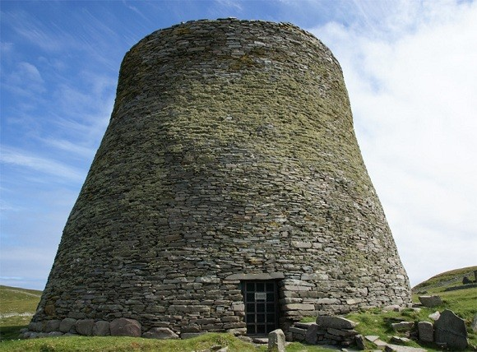
This is the very best preserved one. It is at Mousa in the Shetland Islands. The buildings are called brochs. They are like castles but 1,000 years older.
Brochs are only found in Scotland.
The stairs lead to the top of the broch wall. Can you see the people up there?
If the person on top is about 1.5m tall how high is this broch tower?

Slide 6
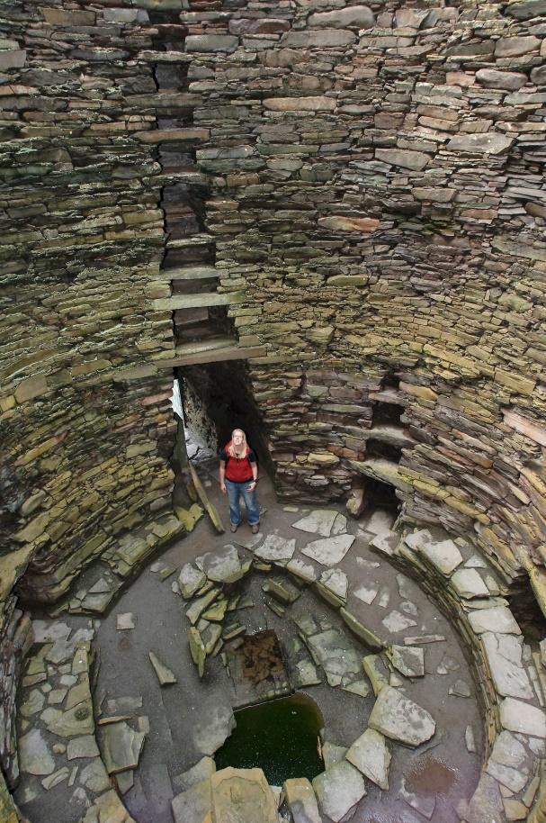
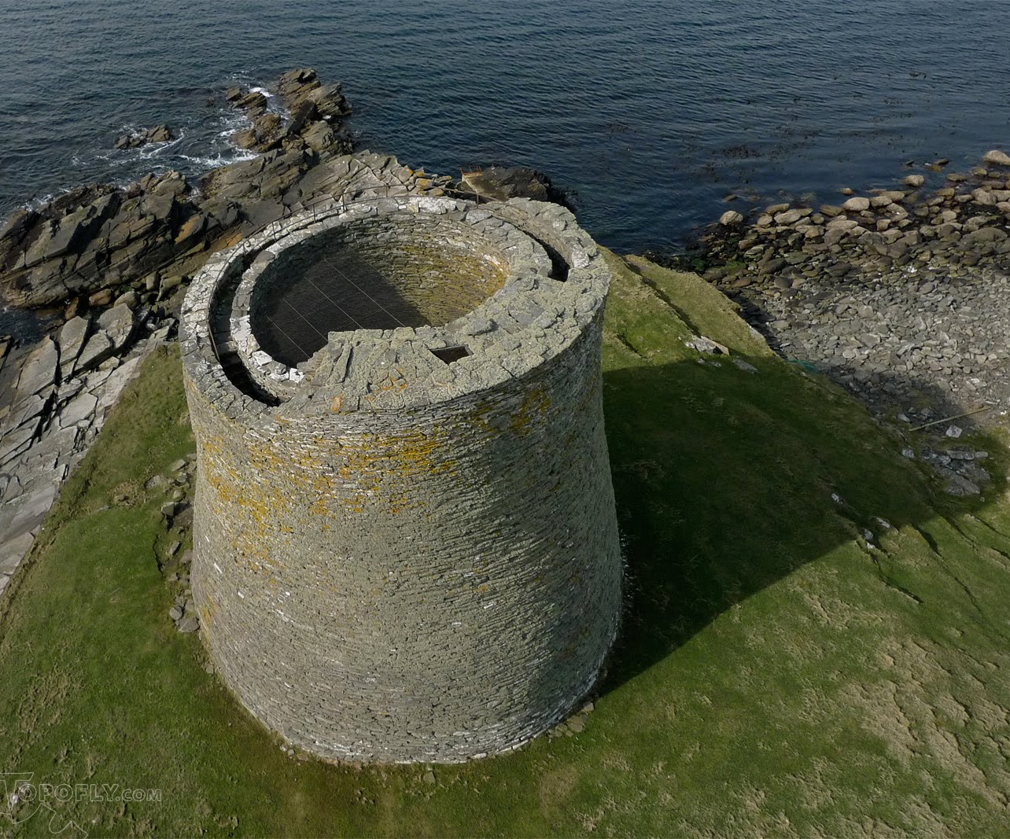
Like all brochs,
it is empty in the middle.
Notes:
Copyright Keiran Baxter

Slide 7
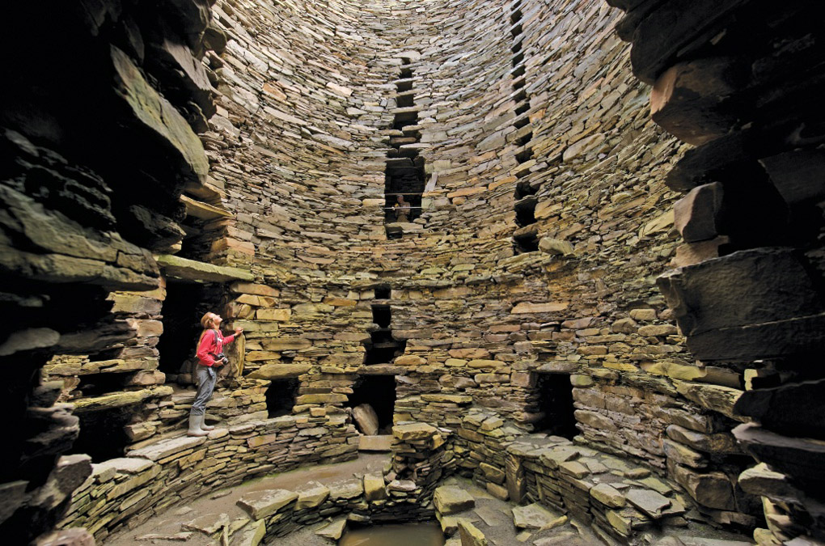
Ledge
But there are lots of openings through the inside wall. Most are windows letting light into the staircase but some are big, like doors. There are also ledges that run around the wall. What do you think they could have been for?

Slide 8
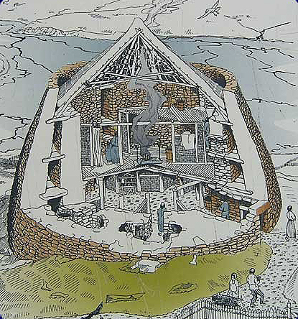
The ledges were to hold wooden floors. The large openings were for doors from the stairs into the rooms.
There was a roof over the top.
Notes:
Courtesy Alan Braby Copyright

Slide 9
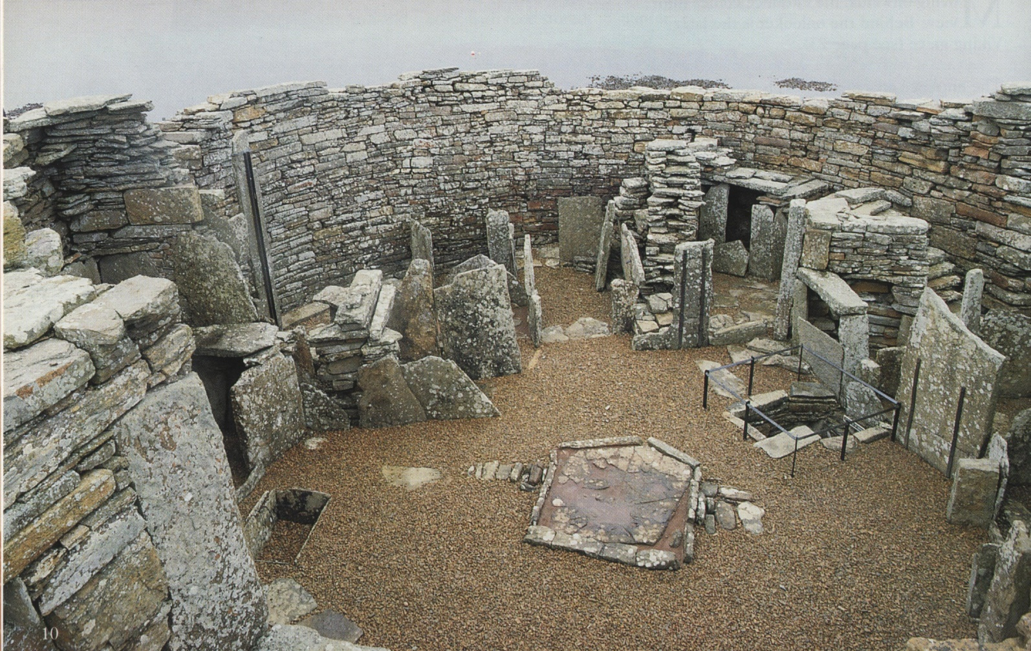
Sometimes stone was used to make the furniture because there was not enough wood, so it hasn’t rotted away.
Can you see the hearth?
Can you see the well next it?

Slide 10
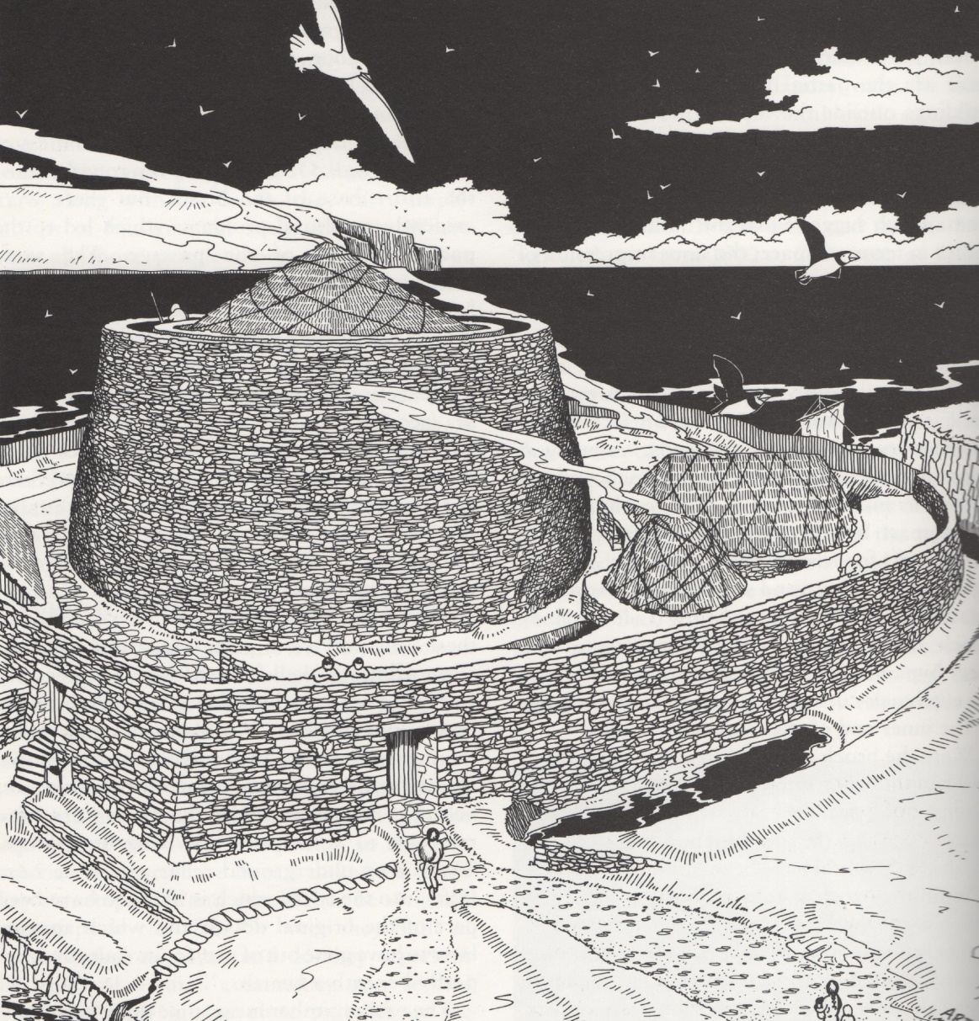
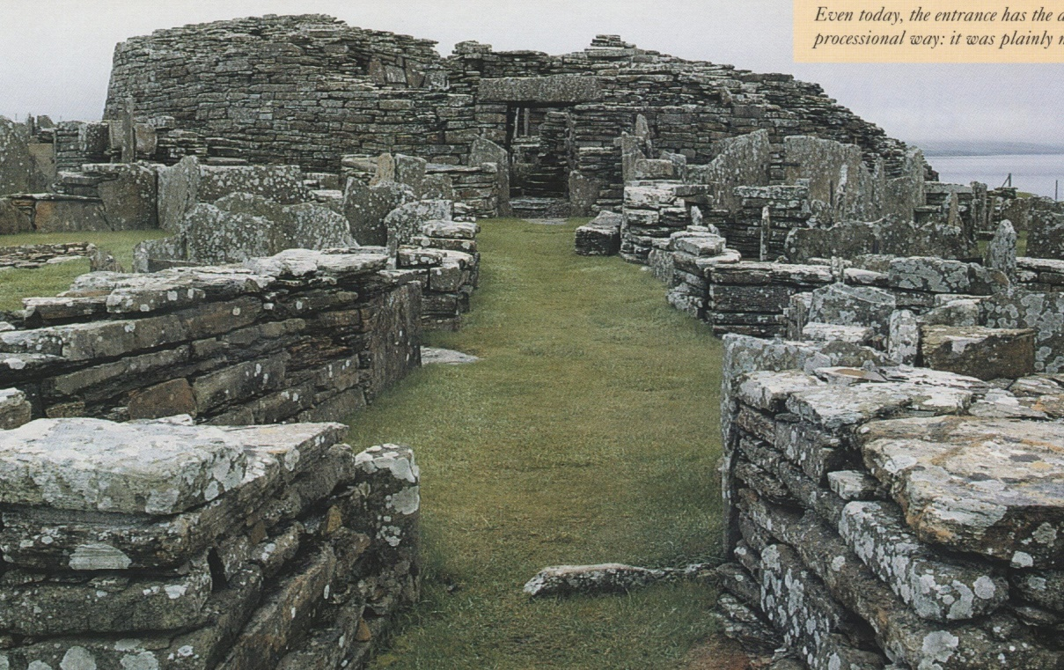
Some broch towers, like these two on the Orkney Islands, had houses built around them.
Notes:
Courtesy Alan Braby copyright

