Slide 1
PREHISTORIC BRITAIN
We find out about the past
by reading what people wrote.
But that only takes us back about 2,000 years.
People lived in Britain 500,000 years before that.
Prehistory is the name we give to that enormous period of time. It means ‘before history’.
How can we find out about what went on then?
Notes:
Image: Imperial College London/Chase Stone
http://www.sciencemag.org/news/2017/04/original-brexit-how-tremendous-ice-age-waterfalls-cut-britain-europe

Slide 2
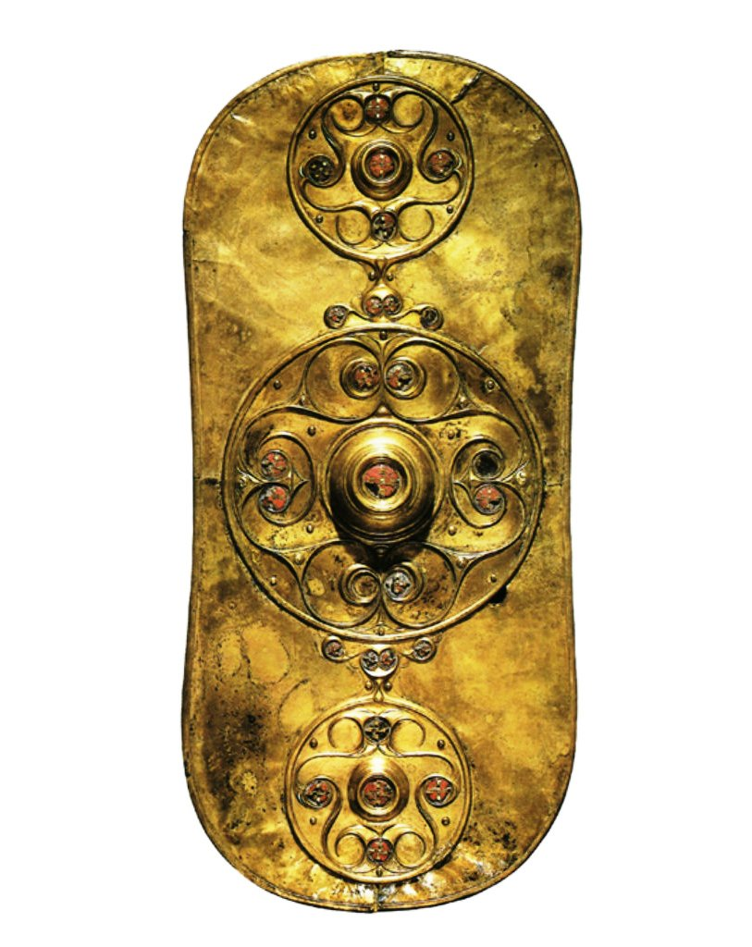
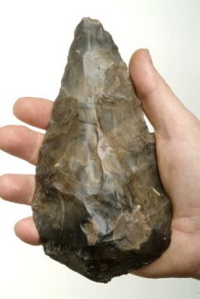
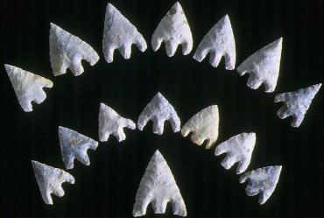
Artefacts
Archaeologists look at the things people made.
They are called artefacts.
Notes:
Images (left to right): Handaxe © Museum of London; arrowheads © Wessex Archaeology; bronze shield © Trustees of the British Museum

Slide 3
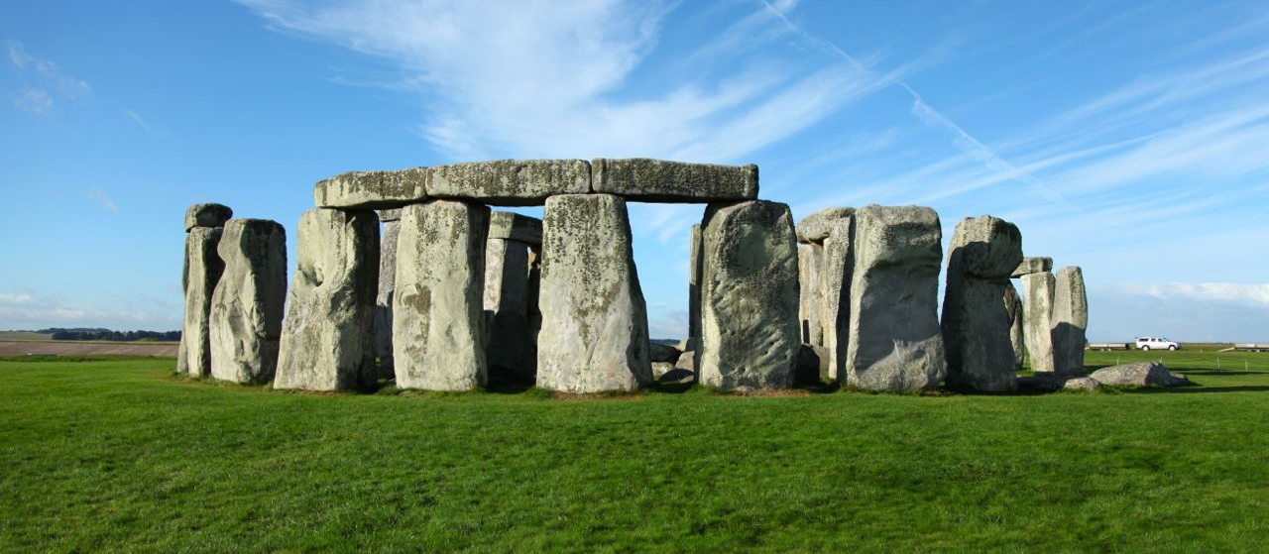
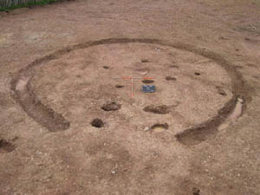
Archaeology
They look at things that survive...
...and marks left in the ground by things that have rotted away
Notes:
Images (top to bottom): Stonehenge; excavated hut circle (courtesy: Cornwall Archaeology)

Slide 4
The discovery of the cave at Lascaux
In September 1940, 18-year-old Marcel Ravidat was walking his dog on a hill called Lascaux near the village of Montignac in France. His dog was chasing rabbits. It sniffed at all the rabbit holes and then began sniffing at a hole made by the roots of a fallen tree. Ravidat realised this hole wasn’t a rabbit burrow. He peered into the small gap but could see nothing. When he told his friends they decided to make the hole bigger, then get inside and explore it. All they took with them was a home-made oil lamp and a large knife. They set to work using the knife to prise out stones. The hole got steadily wider. Then suddenly Marcel, who was pulling out stones at the bottom, fell through. He landed on the floor of a pitch black cave. After shouting up that he was OK, his friends scrambled down to join him, bringing the oil lamp. When they lit it they got a big shock. Across the walls and roof of the cave were pictures of horses and a massive bull! Once they had recovered from the fright, they carefully explored further. There were paintings in vivid colours everywhere.
Notes:
Images (left to right):

Slide 5
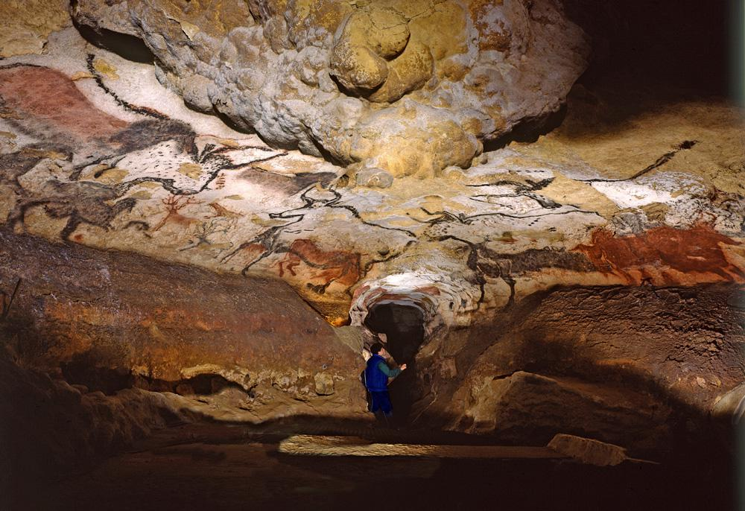

Slide 6
They kept their secret for a couple of days, exploring deeper into the cave and finding more and more paintings. As they talked excitedly about their discovery they remembered what the teacher in their school had told them – during the Ice Age, 20,000 years ago, people had sometimes painted animals on cave walls. When they returned to the village this time they went to see him and told their story. He didn’t believe it at first. Then, realising it could be a very important discovery, he sent a letter telling archaeologists in Paris. Within a week, they had come to Montignac. After being led into the cave by Marcel and his friends they were astonished and declared it one of the greatest discoveries of all time.

Slide 7
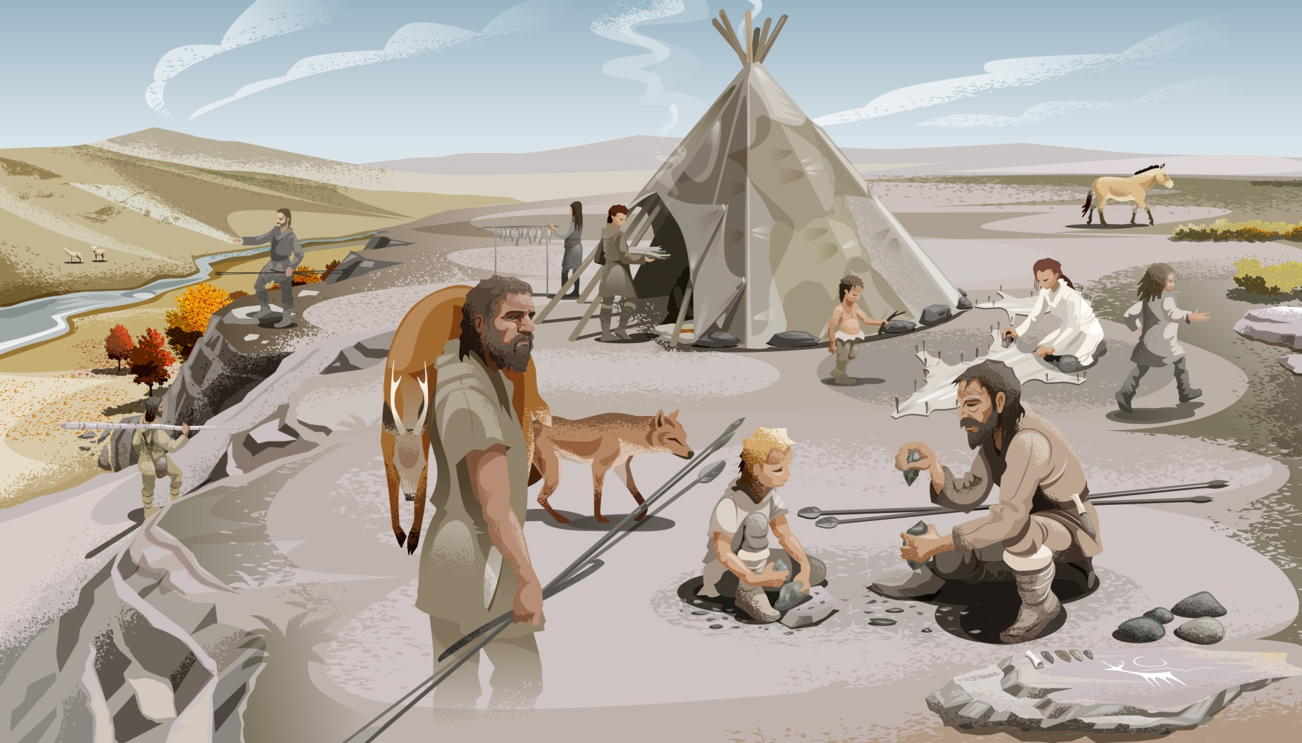
The people who painted the pictures in the cave at Lascaux lived by hunting animals and gathering plants and berries. They didn’t know about farming. So they had to live in tents of animal skins and sometimes in the entrances to caves.
Does that mean they weren’t as intelligent as us?
Notes:
© The Bradgate Park Trust

Slide 8
Thinking like the people who painted Lascaux
We know they looked like us and had brains as big as ours, so lets pit our brains against theirs.
The animals were too big to take down into the small cave to draw them.
They didn’t have paper and pencils so they couldn’t take small pictures down to copy.
They had to have the pictures in their brains.
We have pictures in our brains too. We all know what a cow looks like. So try drawing a side view of a cow’s head from memory.
ONLY TURN TO THE NEXT PICTURE WHEN YOU HAVE ALL FINISHED.
Notes:
Images (left to right):

Slide 9
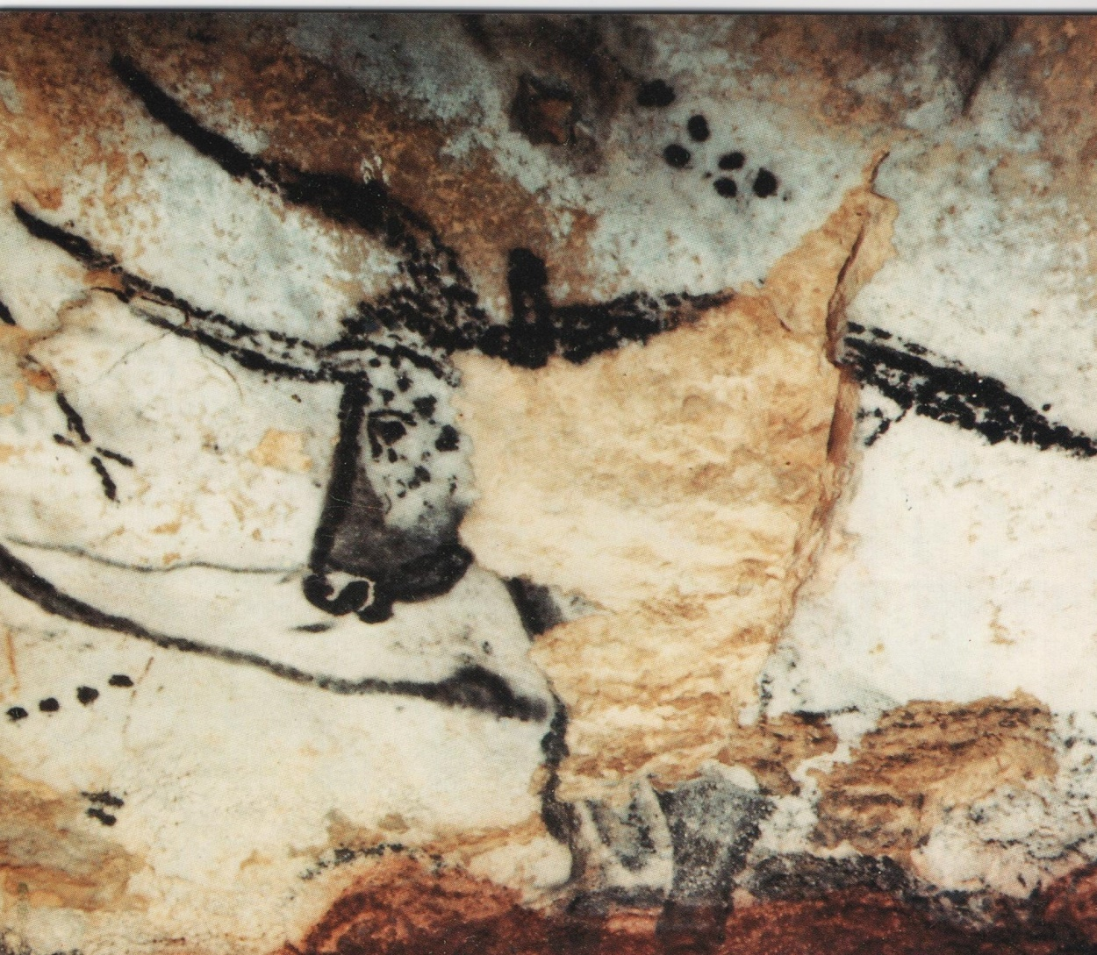
Is your drawing better or worse than this one that was drawn nearly 20,000 years ago?
Notes:
Image:

Slide 10
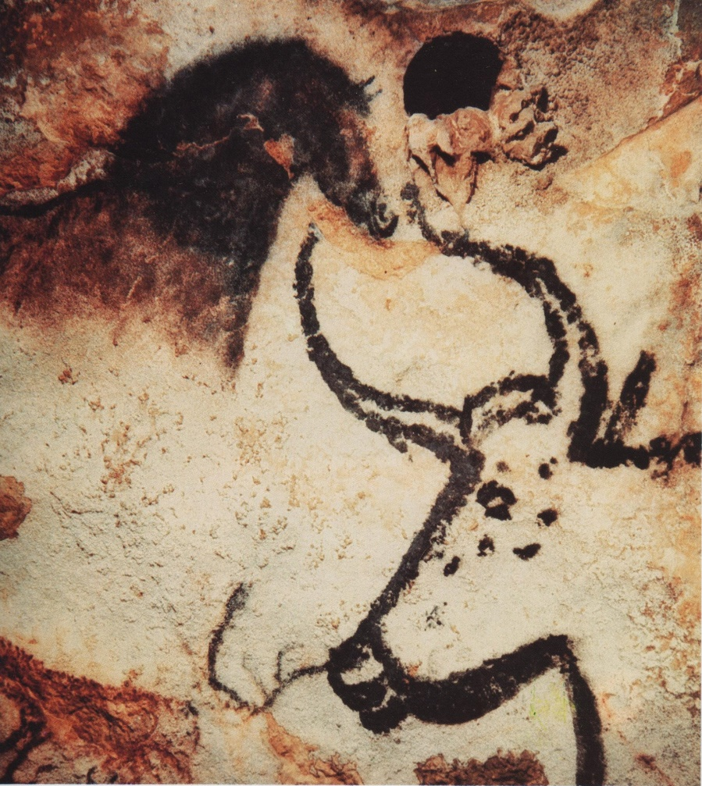
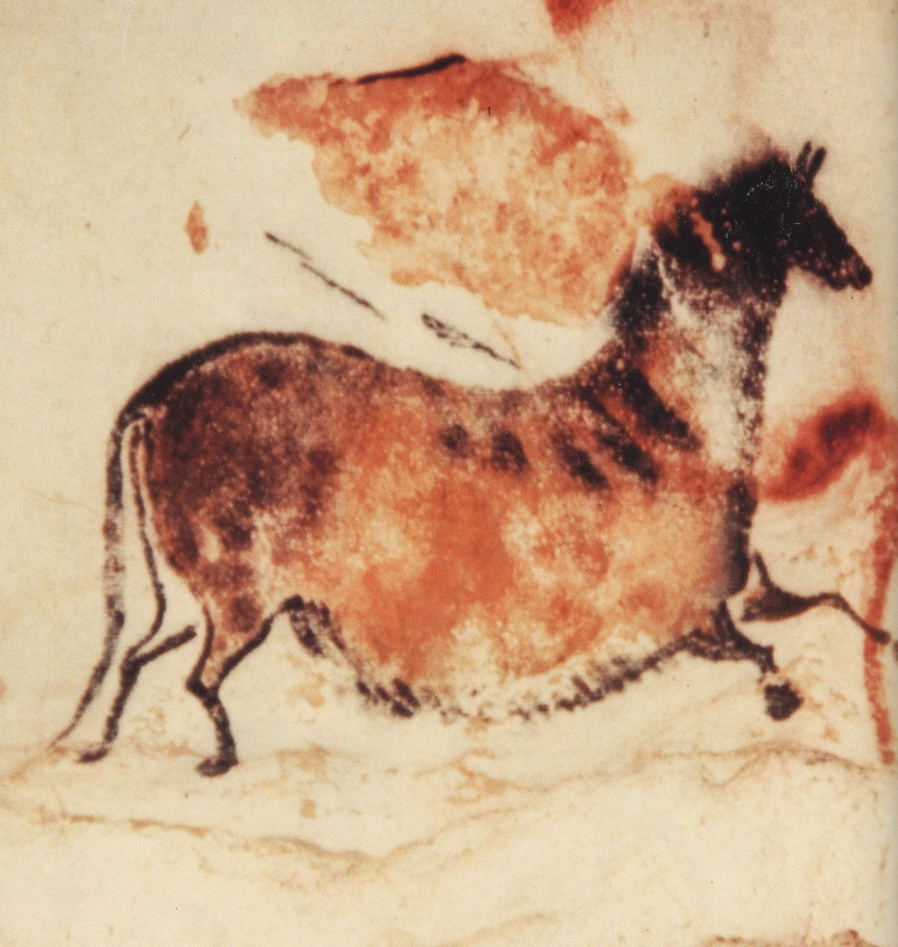
More images from the cave at Lascaux
Notes:
Images (left to right):

Slide 11
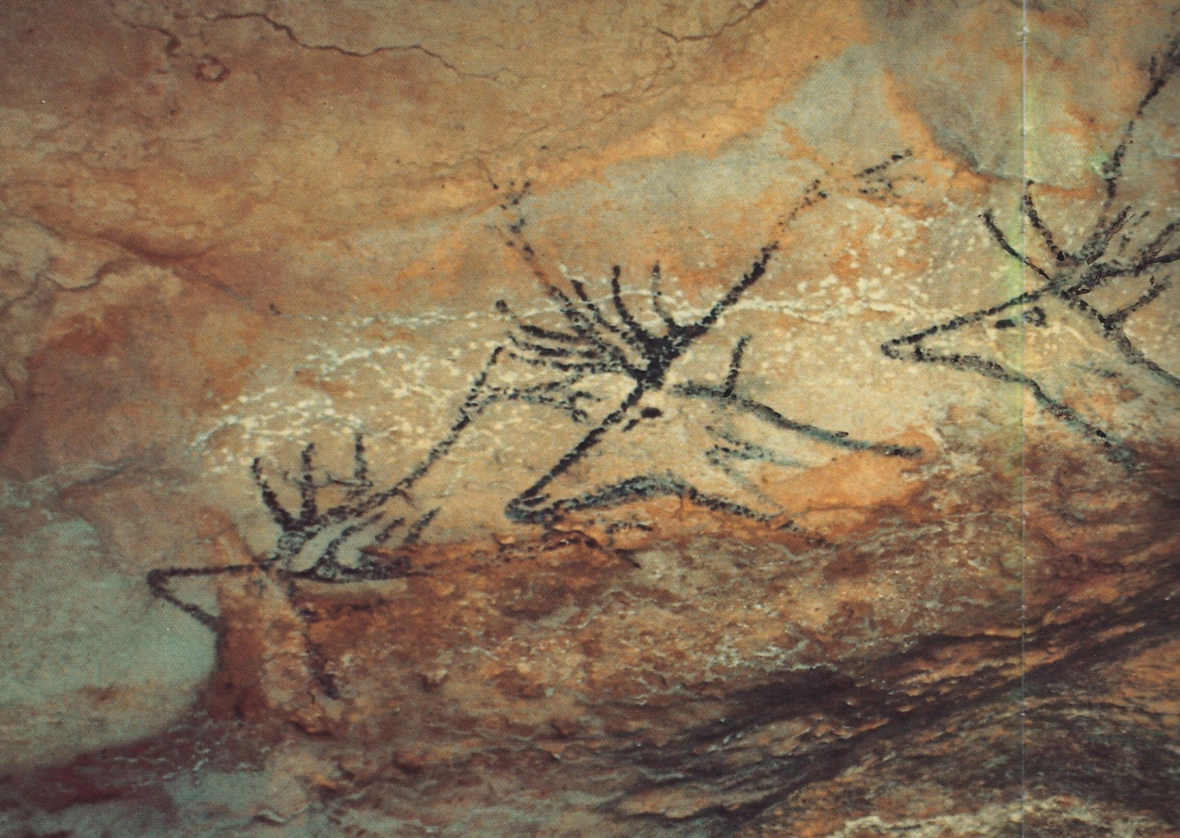
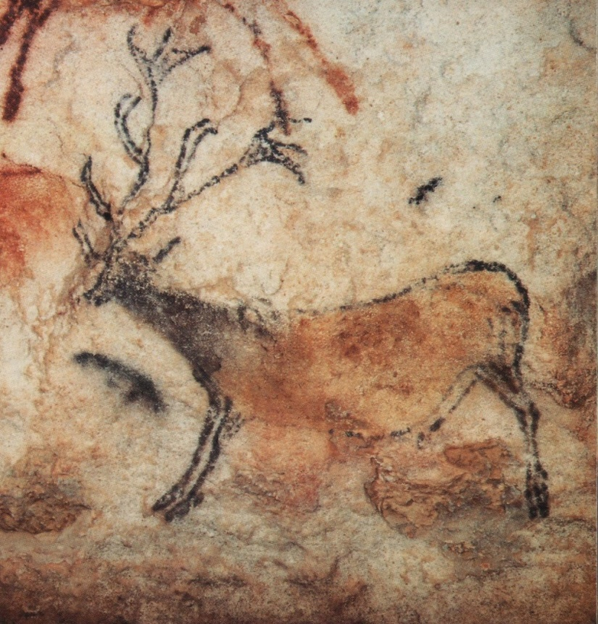
More images from the cave at Lascaux
Reindeer
Do you think these deer have been painted to look as if they are swimming across a river?
Notes:
Images (left to right):

Slide 12
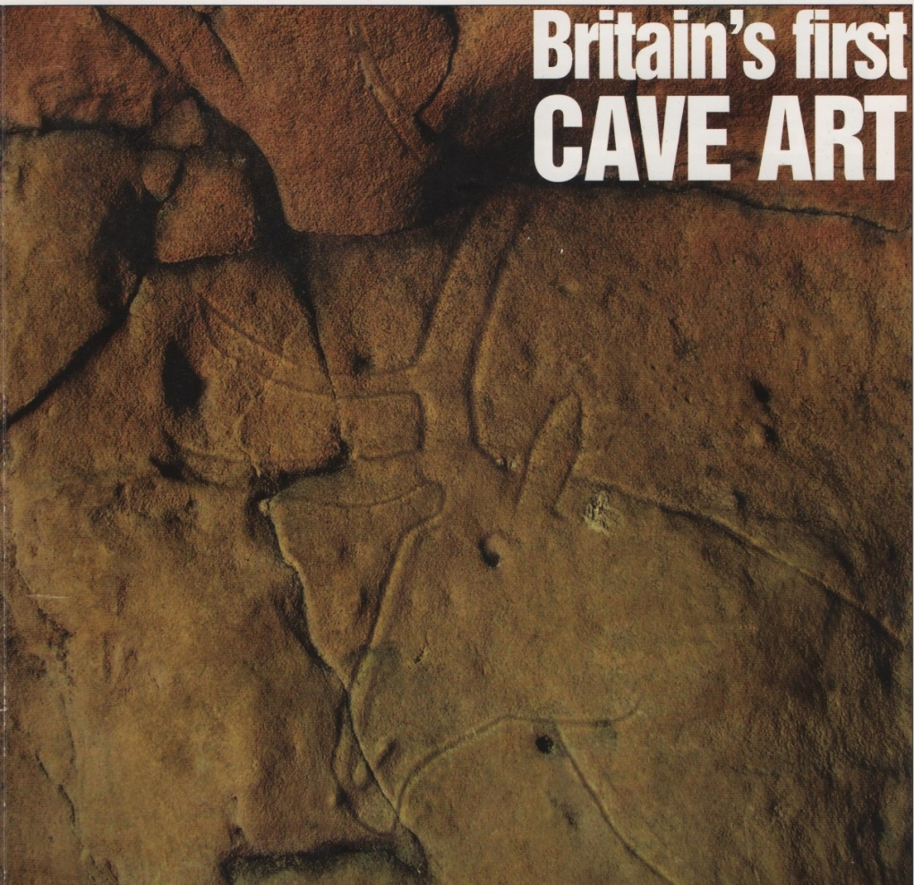
Cave art in Britain
This picture was scratched on a cave wall at
Cresswell Crags in Nottinghamshire.
What animal do you think it is?
Notes:
Image: Courtesy of Current Archaeology

